Slide 1
E- SafETY
https://www.o2.co.uk/help/nspcc/parents-vs-kids/play#/

Slide 6
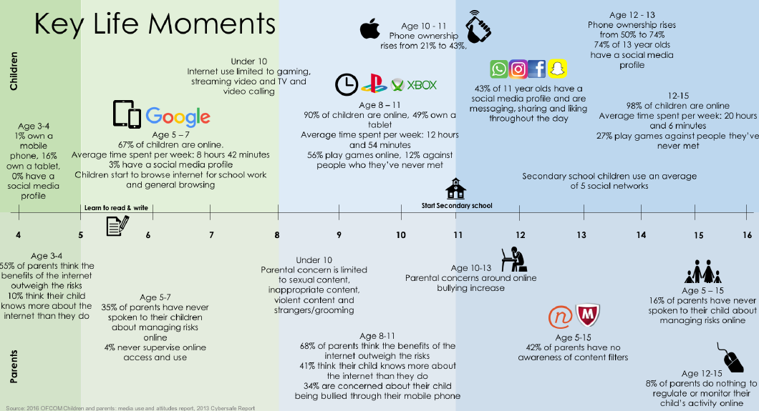

Slide 7
Online safety: where to start
The most important thing you can do is talk to your children about what they do online and how they can stay safe. But it can be difficult to know where to start.

Slide 9
How do I keep my children safe on social media?
Seven tips to help you keep your children safe when they're using social media.

Slide 12
How do I turn off location settings?
Follow the guidance from our O2 guru below about showing your child how to turn location settings on and off when needed.

Slide 14
My child has seen inappropriate content – what should I do?
Children might come across inappropriate content online. Innocent searches can sometimes lead to not so innocent results. Or children might look for things because they are curious. If your child has seen inappropriate content online, you can:
Talk to your child about what they’ve seen
They might have questions or worries that you can answer. It’s also a good opportunity to let them know what is, and isn’t, appropriate for their age.
Reassure them
Tell them you’re glad they spoke to you about this and let them know they can come to you, another trusted adult, or Childline about something they’re concerned about.
Set up parental controls
You can find out more about parental controls or call our advice line on 0808 8005002 for help on specific social networks, apps and games.
Report the content
You can report inappropriate content on most apps, sites or games. If you’ve seen something worrying or illegal you should report this to CEOP.

Slide 15
How do I set up parental controls?

Slide 16
CONTENT
CONTACT
CONDUCT

Slide 17
What do we do in school to support children with this?

Slide 18
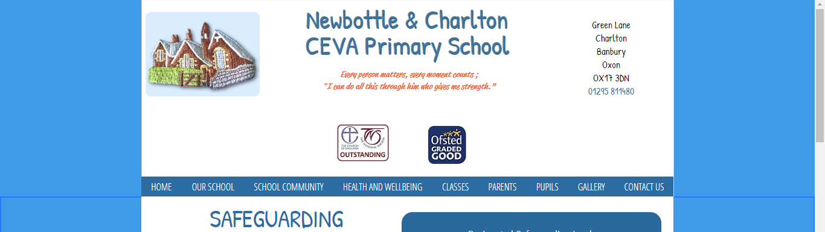
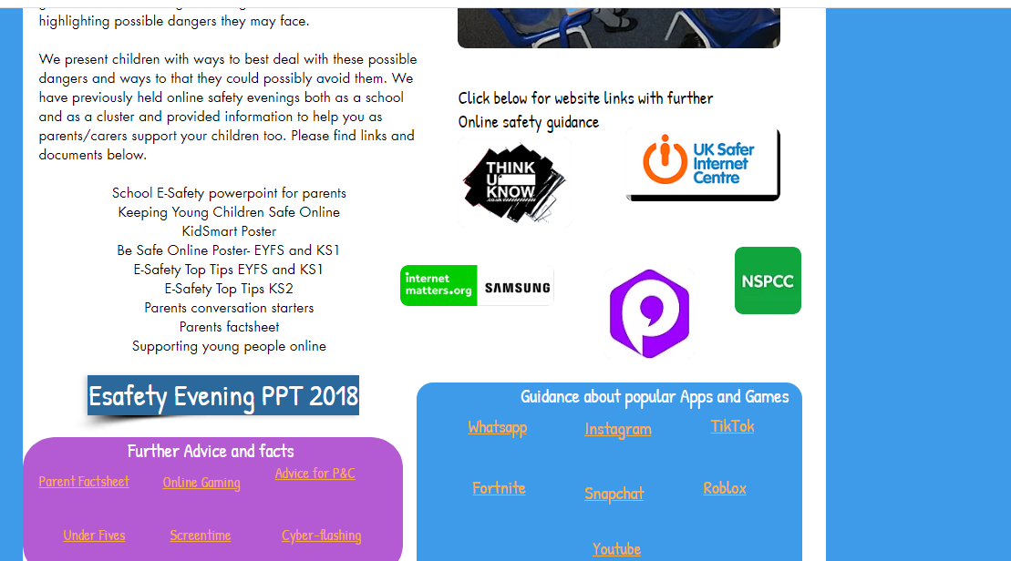

Slide 19
#Wakeupwednesday campaign
https://nationalonlinesafety.Com/guides

