Slide 1
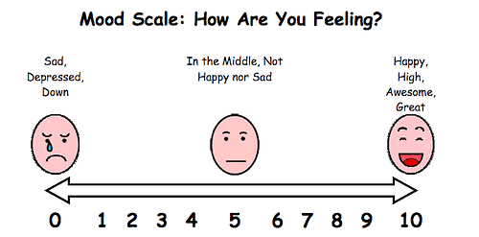
Mental Health and Well-being

Slide 2
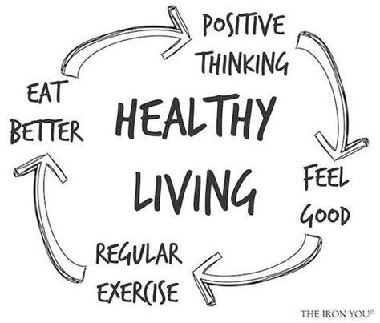
Keeping Healthy
How can we keep healthy?
Exercise
Diet
Well Being

Slide 5
a coordinated multi-agency programme
building capacity within schools
training, support, introducing new programmes and approaches
better meet the mental health needs of all children
Bronze, silver and gold accreditation

Slide 6
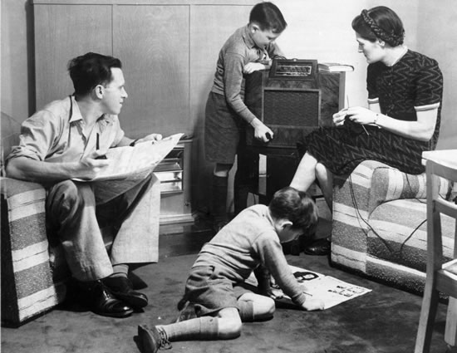
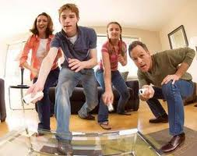
1957
3 times as wealthy
52% very happy
36%
Notes:
In 1957 52% of people said they were very happy
Today we are 3 times richer today than in the 1950’s
But only 36% of people today say that they are happy.
Research shows us that we are looking for happiness in the wrong places.

Slide 7
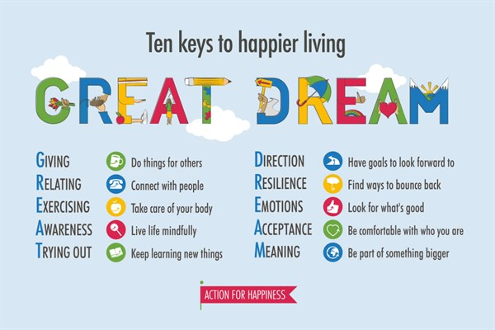

Slide 8
Regular relaxation can help:
• Enhance children’s concentration and focus
• Stimulate imagination and creativity
• Encourage discussion, thought and development
• Help build character and self-esteem in each child
• Introduce values into the classroom
• Encourage children to feel positive about themselves
• Recognise, name and deal with feelings in a positive way

Slide 9
Mindfulness

Slide 10
Mindfulness
How to be more mindful
Reminding yourself to take notice of your thoughts, feelings, body sensations and the world around you
Notice the everyday
sensations of things, the food we eat, the air moving past the body as we walk
Keep it regular
e.g. the morning journey to work or a walk at lunchtime
Name thoughts and feelings
To develop an awareness of thoughts and feelings, some people find it helpful to silently name them: "Here’s the thought that I might fail that exam". Or, "This is anxiety".
Free yourself from the past and future
You can practise mindfulness anywhere, but it can be especially helpful to take a mindful approach if you realise that, for several minutes, you have been "trapped" in reliving past problems or "pre-living" future worries.

Slide 11
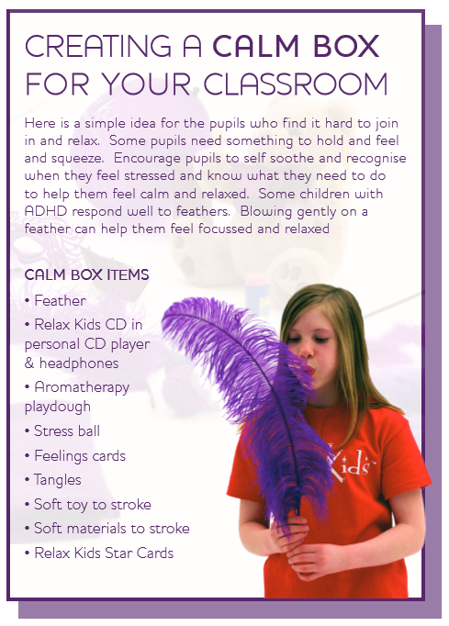

Slide 12
NORTHAMPTONSHIRE MENTAL HEALTH AWARENESS DAY TAKES PLACE ON FRIDAY 9 FEBRUARY 2018
Challenge Tessa! Visiting over 70 schools
A set of resources for primary schools have been developed for use on, or leading up to, the day that include:
Chatterboxes for Year 6 students
Information leaflets for students
A PowerPoint presentation for use in assembly
Posters to promote Mental Health Awareness Day
Bookmarks for each child

