Slide 1
CPA Approach and Bar Modelling

Slide 2

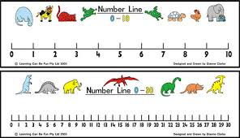
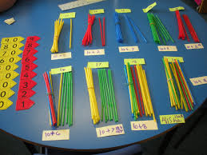
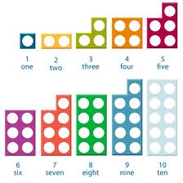
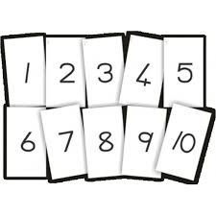
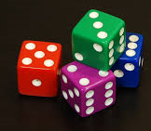
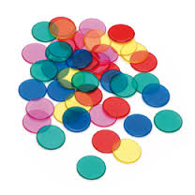
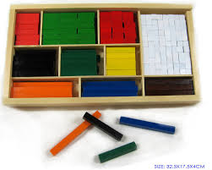
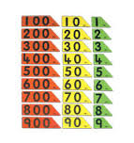
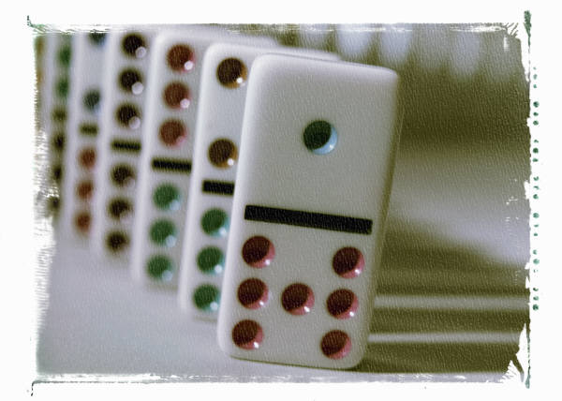
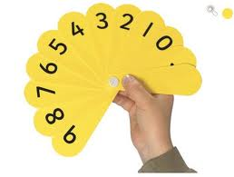
Use of Concrete Materials (Manipulatives)

Slide 3
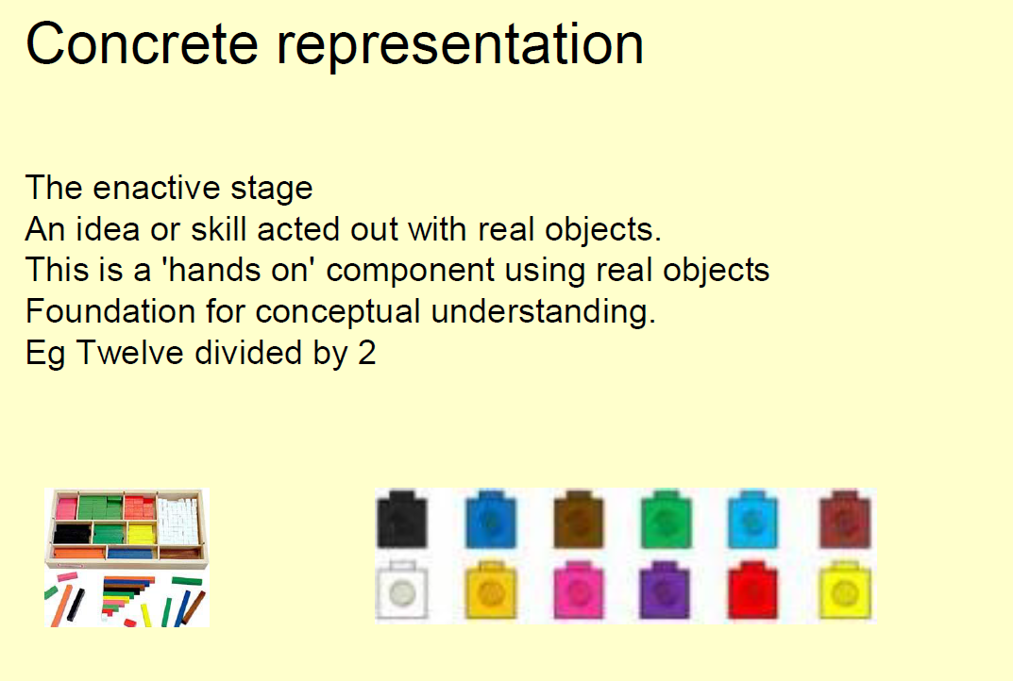

Slide 4
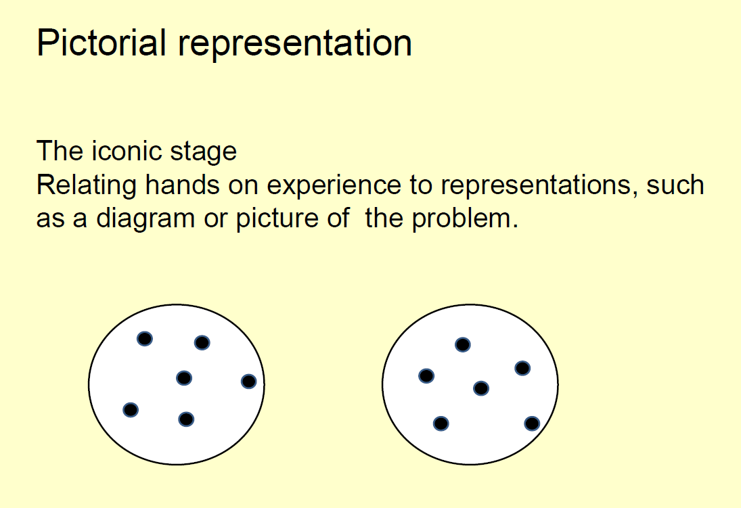

Slide 5
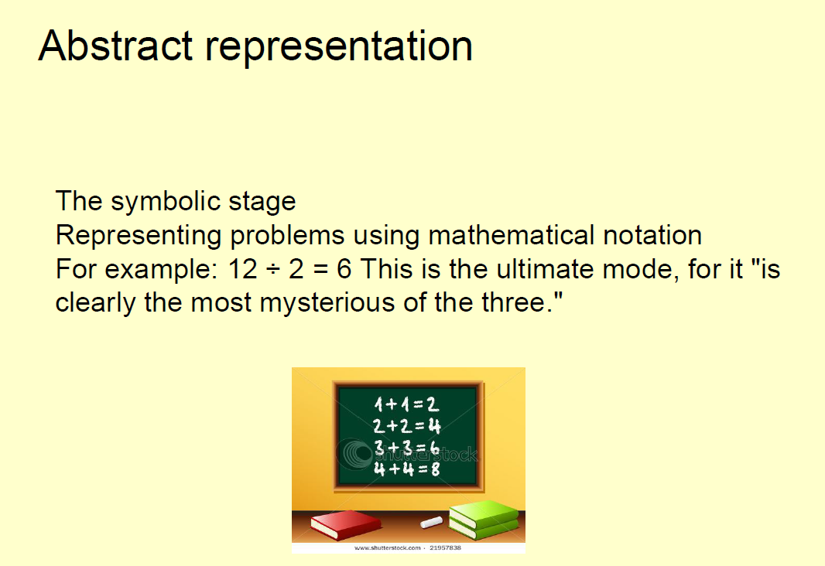

Slide 6
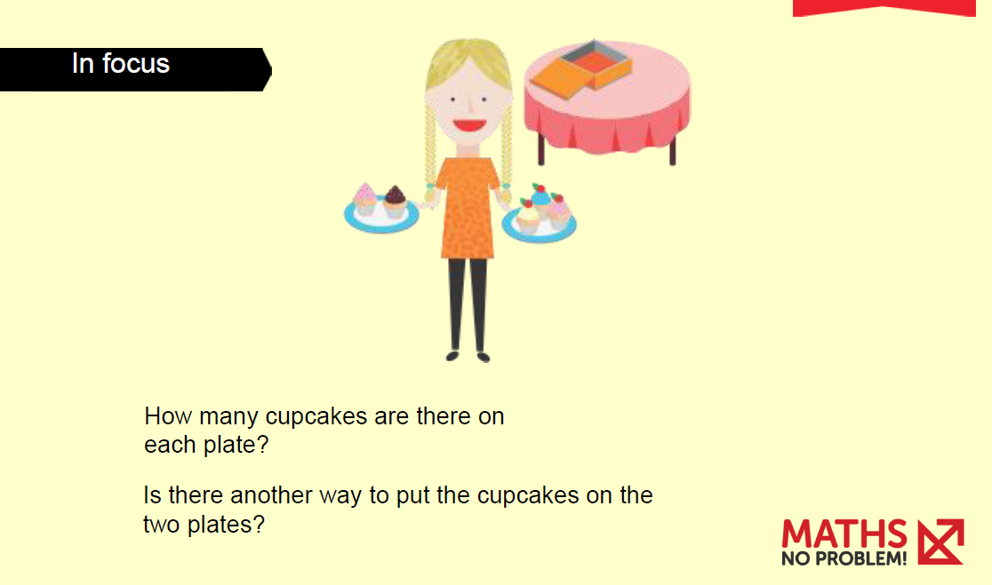

Slide 9
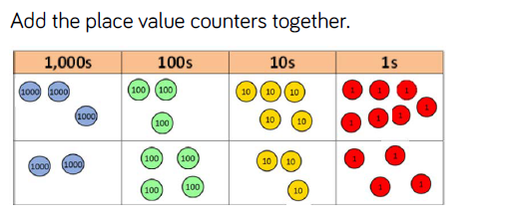

Slide 10

Look at the result for each column; what do you notice?
Exchange ten ones for a 10 counter and move it to the tens column.
What is the final result?
Now write the same calculation in numbers, showing the exchanged 10 underneath the tens column.

Slide 11
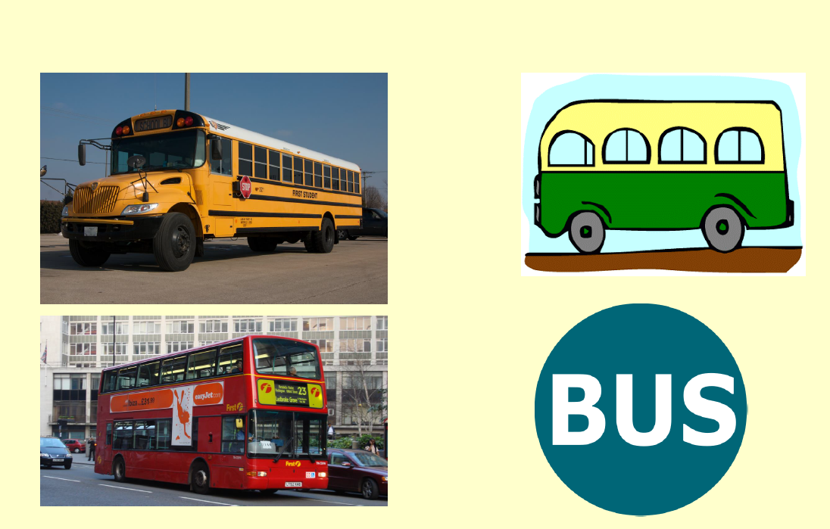

Slide 12
PROBLEMS
Tom has 20 sweets and shares some of them with his sister.
He gives his sister five.
How many does he have?

Slide 13
Key Stage 2 Sats- 2012
In a class, 18 children are girls.
A quarter of the children in the class are boys.
Altogether how many children are there in the class?

Slide 14
The bar model is best used to help children visualise and represent their mathematical thinking. It will complement other mathematical knowledge, such as that around mental maths strategies.

Slide 15
Advantages of bar modelling
Importantly, bar modelling leads students down the path towards mathematical fluency and number sense.
Instead of simply following the steps of any given formula, students will possess a strong understanding of what is actually happening when applying or working with formulas.

Slide 16
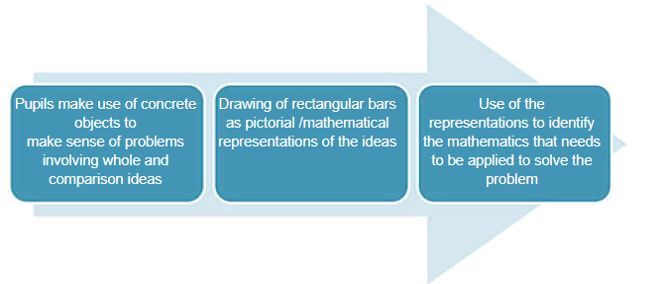

Slide 17
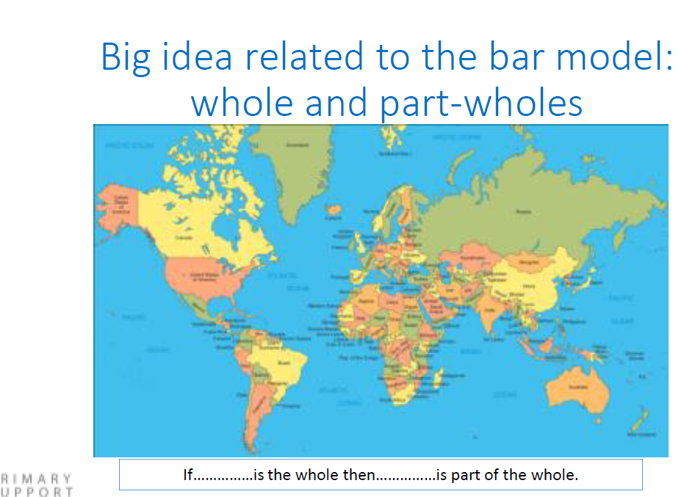

Slide 18
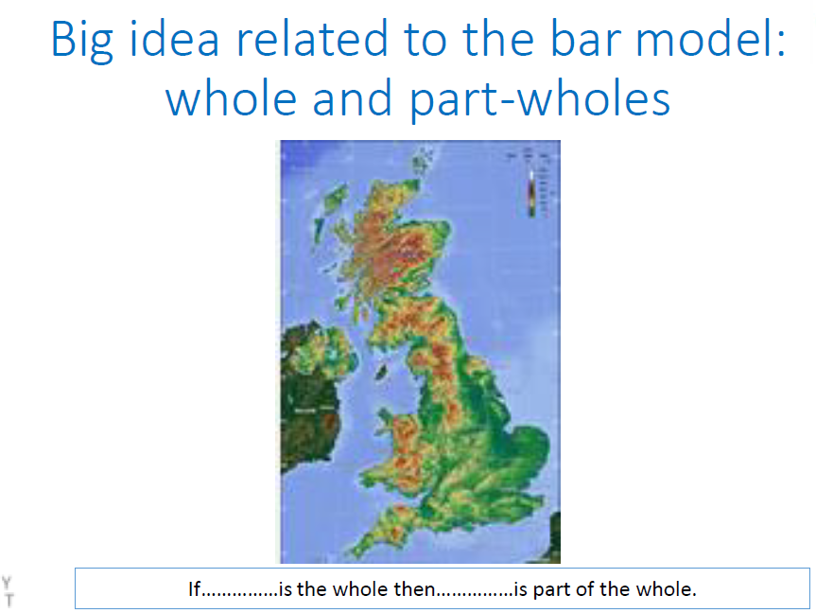

Slide 19
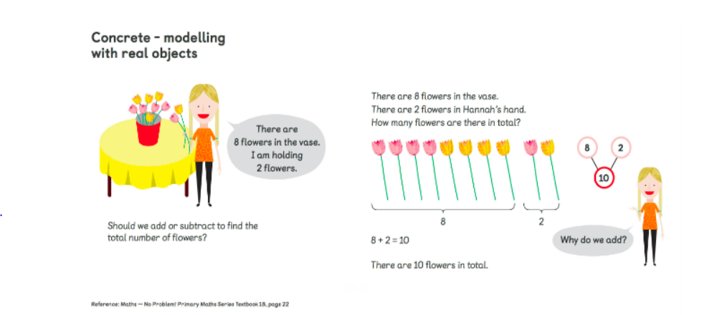
The bar model method draws on the the concrete, pictorial, and abstract (CPA) approach — an essential maths mastery concept. The process begins with pupils exploring problems via concrete objects. Pupils then progress to drawing pictorial diagrams, and then to abstract algorithms and notations (such as the +, -, x and / symbols).

Slide 20
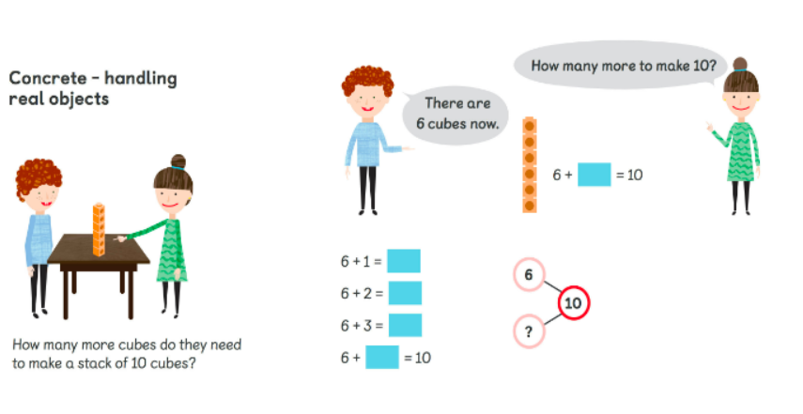

Slide 21
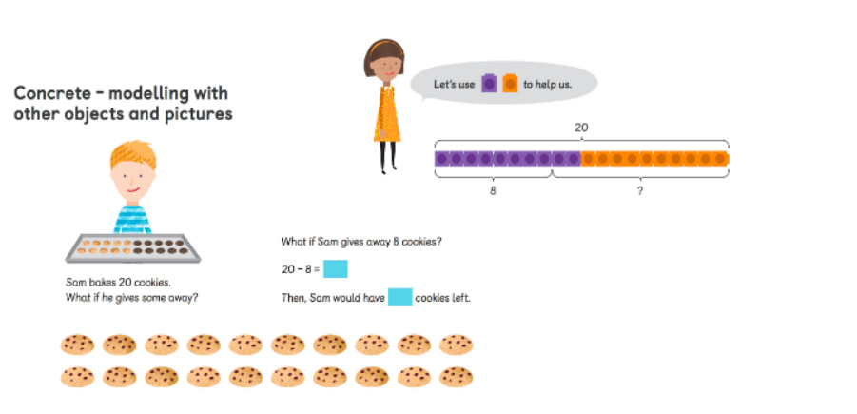

Slide 22
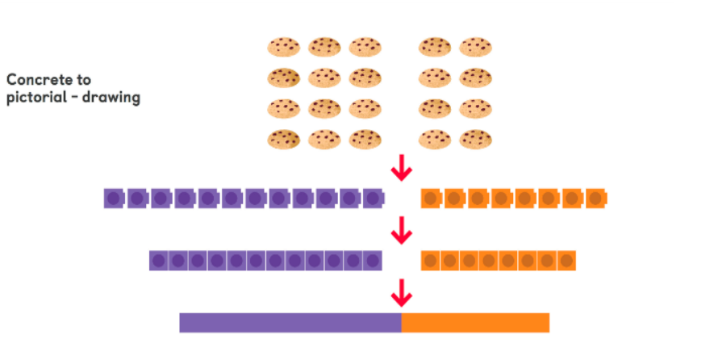

Slide 23

Steps to Bar Modelling
Objects
Space for objects
Area model

Slide 24
Generalising

Slide 25
Pupils will naturally develop from handling concrete objects, to drawing pictorial representations, to creating abstract rectangles to illustrate a problem.
With time and practice, pupils will no longer need to draw individual boxes/units. Instead, they will label one long rectangle/bar with a number. At this stage, the bars will be somewhat proportional. So, in the example above, the purple bar representing 12 cookies is longer than the orange bar representing 8 cookies.

Slide 26
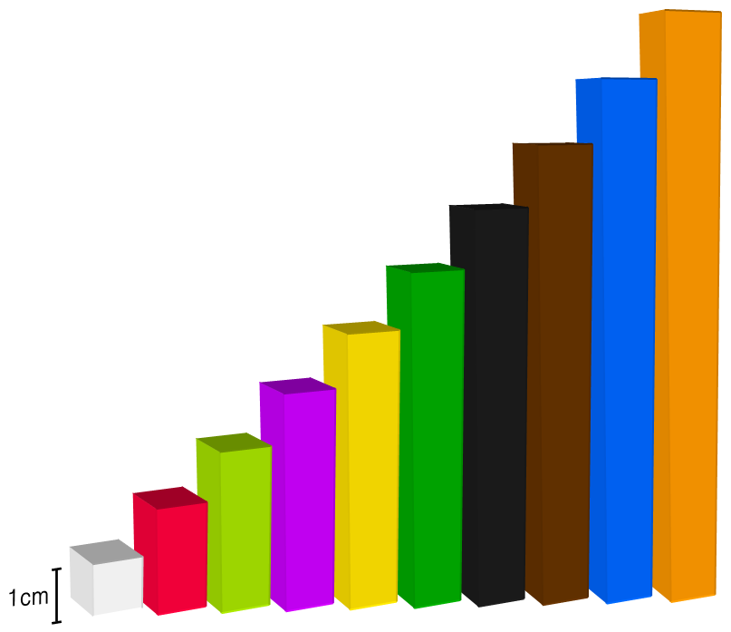

Slide 27

I’m thinking of a number
I’m thinking of a number. If I triple it and add 3. I get 15. What is my number?

Slide 28
Big idea related to the bar model: Proportionality
Take a strip and paper clip:

Slide 29
Representation for number operations- Addition
There are 334 children at Springfield school and 75 at Holy Trinity Nursery. How many children are there altogether?

Slide 30

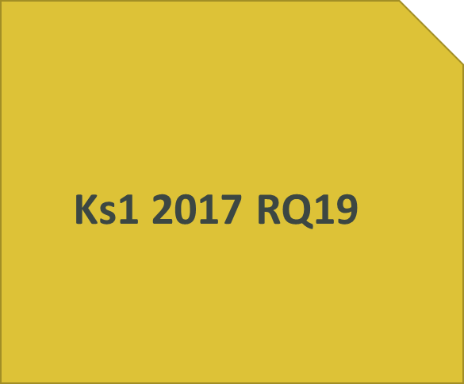
Representation for number operations- Addition
Ben and Sita count cars.
Ben counts 38 red cars.
Sita counts 23 blue cars.
How many do they count altogether?

Slide 31
Representation for number operations- Subtraction
If Tom spends 61p at the corner shop, how much change does he get from £1

Slide 32
Representation for number operations- Multiplication
The sum of two numbers is 60. One number is 4 times as big as the other. What is the bigger number?
Kim has £9 in her purse. Susie has 4 times as much money. How much does Susie have to spend?

Slide 33
Division
A syndicate of six people have to share a £180 prize. How much will they each receive if the money is shared equally between them?
A milk company have 1.25 litres of milk left to pump into ¼ litre cartons. How many cartons will they need before all of the milk is emptied from the container?

